Slide 1
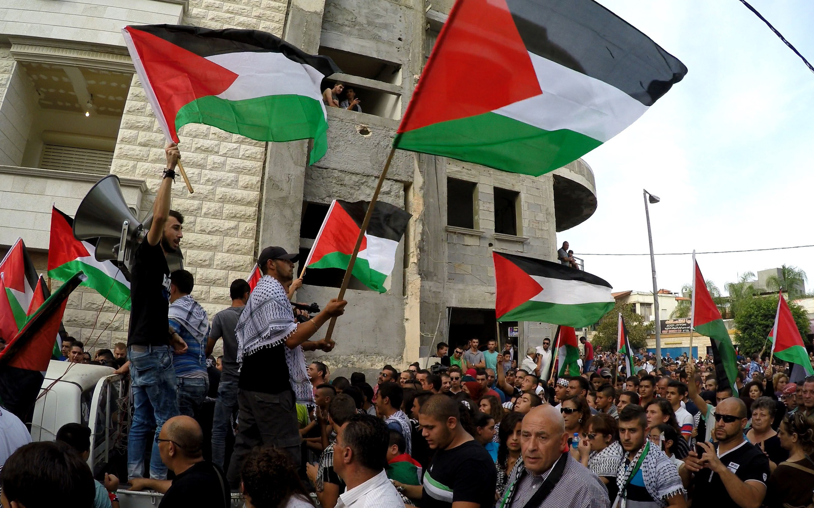
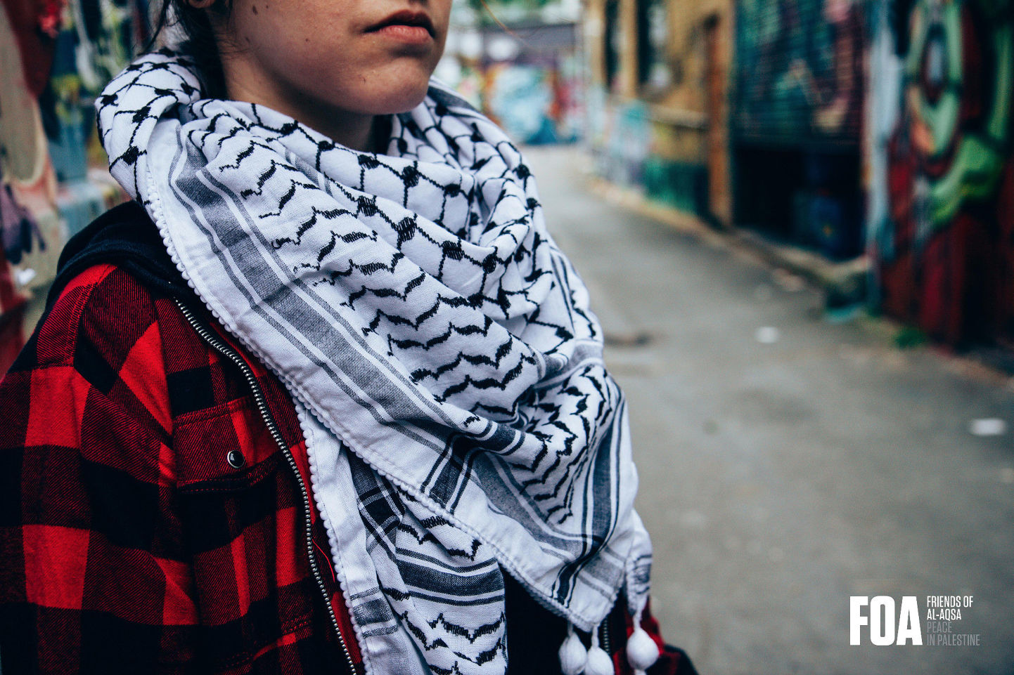
What were the consequences of the Second Intifada for Palestine-Israel?
Lesson 13
What can you remember about the keffiyeh?
What do you think today’s lesson will be about?

Slide 2
Learning objectives
By the end of this lesson, you should be able to:
Describe what the Second Intifada was
Explain the causes of the Second Intifada
Discuss the consequences of the Second Intifada

Slide 3
13a. Cut out and match these keywords and definitions
A meeting between Bill Clinton (US President), Yasser Arafat and Ehud Barak (Israeli Prime Minister) in 2000. No agreement was reached
Al-Aqsa Mosque
Ariel Sharon
Israeli politician and Prime Minister of Israel from 2001 until 2006
2000 Camp David Summit
Another massive uprising of Palestinians against Israel, triggered by the failure of the Oslo Accords and the 2000 Camp David Summit
Second Intifada, 2000-2005
Located in the Old City of Jerusalem, for Muslims this is the holiest site in Jerusalem and the third holiest site in Islam

Slide 4
Stick these matching keywords and definitions into your glossary
A meeting between Bill Clinton (US President), Yasser Arafat and Ehud Barak (Israeli Prime Minister) in 2000. No agreement was reached
2000 Camp David Summit
Israeli politician and Prime Minister of Israel from 2001 until 2006
Ariel Sharon
Another massive uprising of Palestinians against Israel, triggered by the failure of the Oslo Accords and the 2000 Camp David Summit
Second Intifada, 2000-2005
Al-Aqsa Mosque
Located in the Old City of Jerusalem, for Muslims this is the holiest site in Jerusalem and the third holiest site in Islam

Slide 5
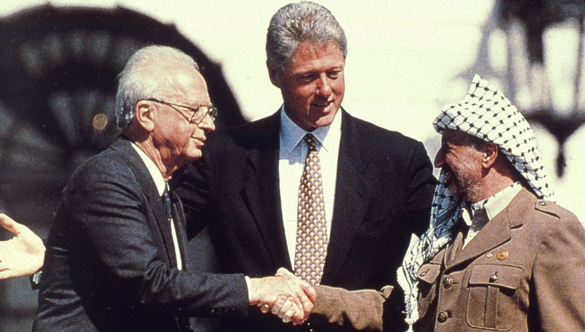
Recap in pairs:
What were the Oslo Accords?
Were the Oslo Accords successful?

Slide 6
From last lesson:

Slide 7
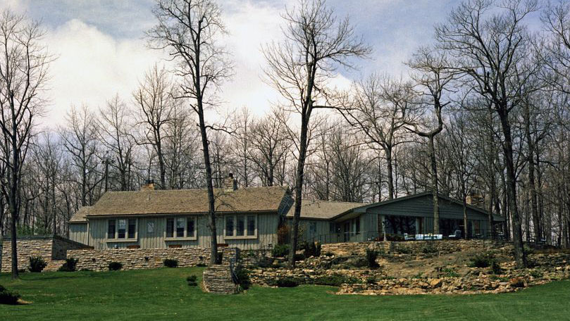
2000 Camp David Summit
What is ‘Camp David’?
Camp David: the country retreat of the US President
Another attempt at peace
Three parties met here in July 2000: Bill Clinton (US President), Yasser Arafat (Head of PLO and now Chairman of the Palestinian Authority) and Ehud Barak (Israeli Prime Minister)
They hoped for a repeat of the 1978 Camp David Accords (when US President Jimmy Carter brokered an agreement between Egyptian President Anwar Sadat and Israeli Prime Minister Menachem Begin), but no agreement was reached

Slide 8
The Second Intifada or Al-Aqsa Intifada (2000-2005)

Slide 9
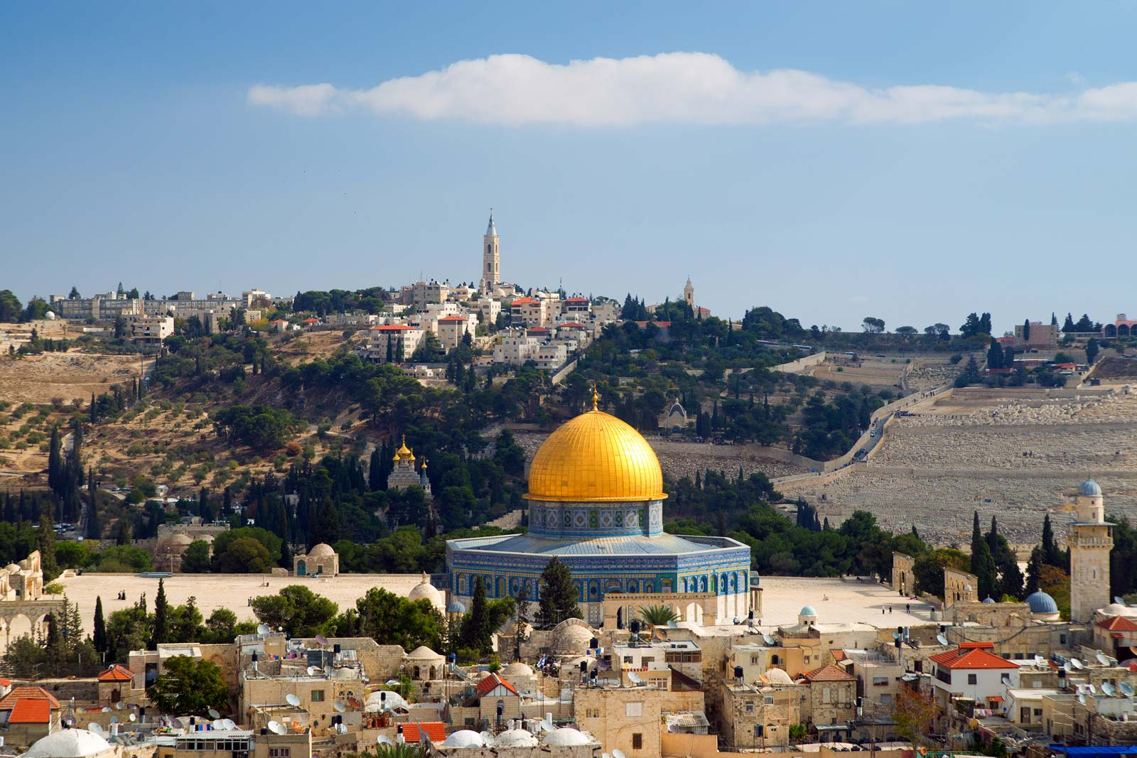
In pairs:
Why is Jerusalem significant to the following religious groups?
Jews
Christians
Muslims

Slide 10
The significance of Jerusalem
For Jews, all of creation began in Jerusalem. The Western Wall in the Old City of Jerusalem is the holiest place where Jews can pray
For Christians, Jerusalem is where Jesus preached, celebrated his Last Supper, died by crucifixion, and was resurrected by God
For Muslims, Jerusalem is from where the prophet Muhammad ascended to heaven. What is the name of the mosque in the photo?

Slide 11
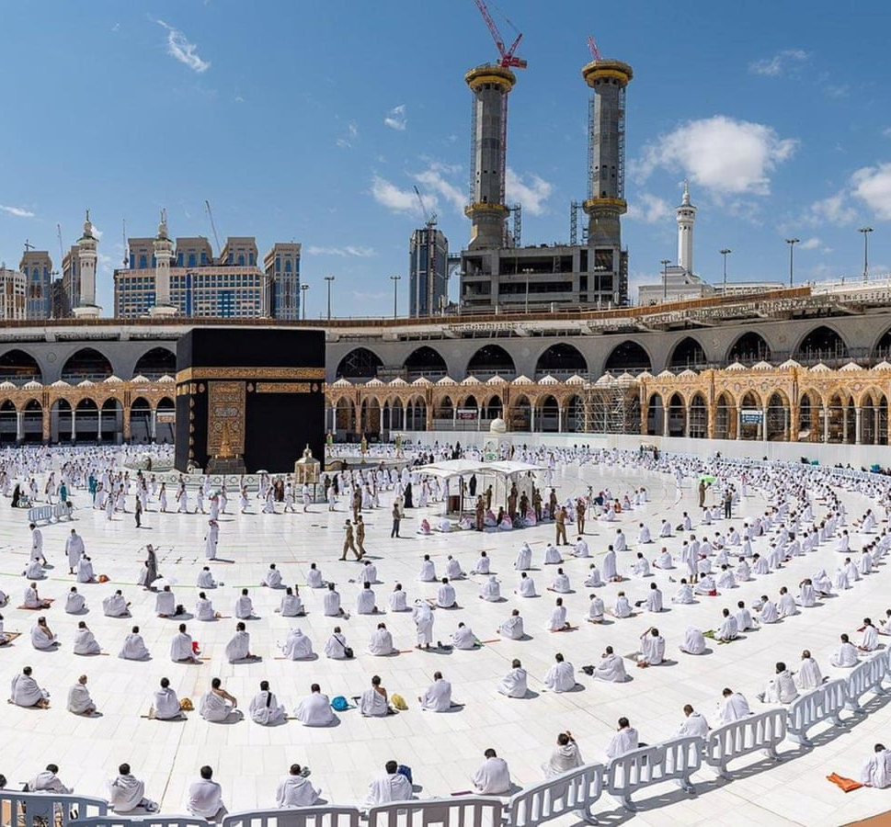
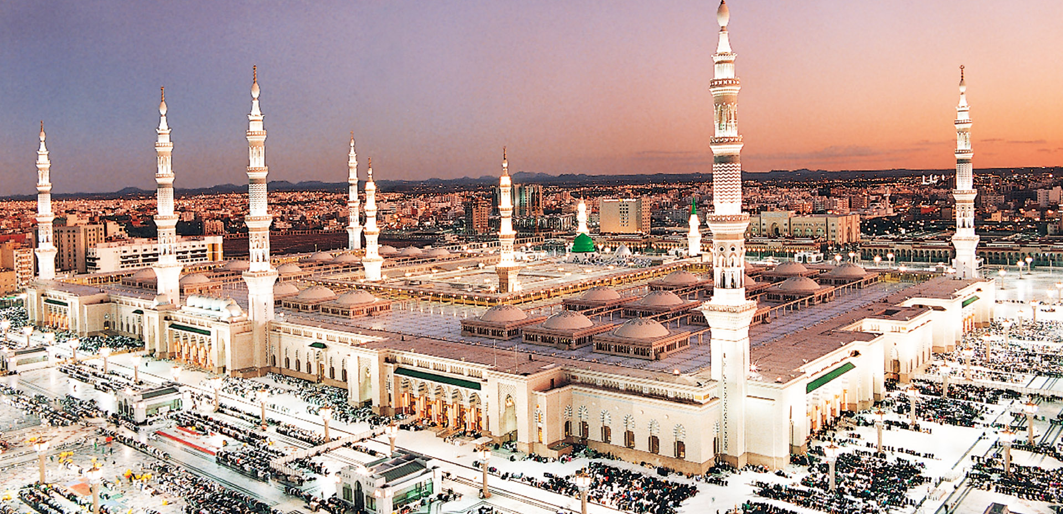
Al-Aqsa Mosque (or Masjid al-Aqṣā)
Over 90% of Palestinians are Muslim
Al-Aqsa Mosque is located in the Old City of Jerusalem and it is the third holiest site in Islam, after Mecca and Medina (pictured)
Al-Aqsa Mosque was the first Qiblah (direction for prayer) and the second mosque ever built!
For Muslims, this is the holiest site in Jerusalem
Mecca
Medina

Slide 12
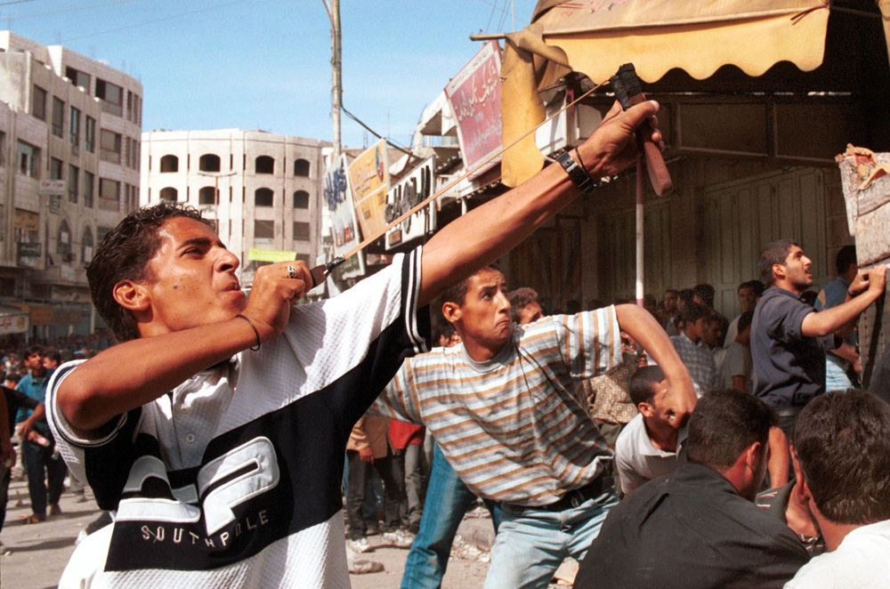
13b. Why was there another Intifada?
The ongoing question of land: Israel still occupied the West Bank, Gaza and East Jerusalem!
Continued disagreement about Jerusalem: Israel had now occupied East Jerusalem since 1967! Who should have access to the Al-Aqsa Mosque area in the Old City? For Muslims, this is the third holiest site in Islam. For Jews, this is where all of creation began
28th September 2000: Israeli Prime Ministerial candidate Ariel Sharon visited the Al-Aqsa Mosque area. Many Palestinians saw this as antagonistic, and the Second Intifada began
The ongoing Palestinian refugee crisis: by 2000 there were 5 million Palestinian refugees in Israel and the occupied Palestinian territories

Slide 13
Why was there another Intifada? (contd.)
16th-18th September 2000: the anniversary of the Sabra and Shatila massacre. It had recently been ruled that Israeli Prime Ministerial candidate Ariel Sharon bore some personal responsibility for what had happened
The continued construction of illegal Israeli settlements: Israel was still demolishing Palestinian homes and allowing settlements to be built on Palestinian land, despite multiple UN Security Council Resolutions condemning this:
Resolution 237 (1967), Resolution 252 (1968), Resolution 267 (1969), Resolution 271 (1969), Resolution 298 (1971), Resolution 465 (1980)
The Oslo Accords had failed, and so had the Camp David Summit in July 2000
What can you remember about the Sabra and Shatila massacre of 1982?
With a partner: How do you imagine Palestinians felt in 2000? Why?

Slide 14
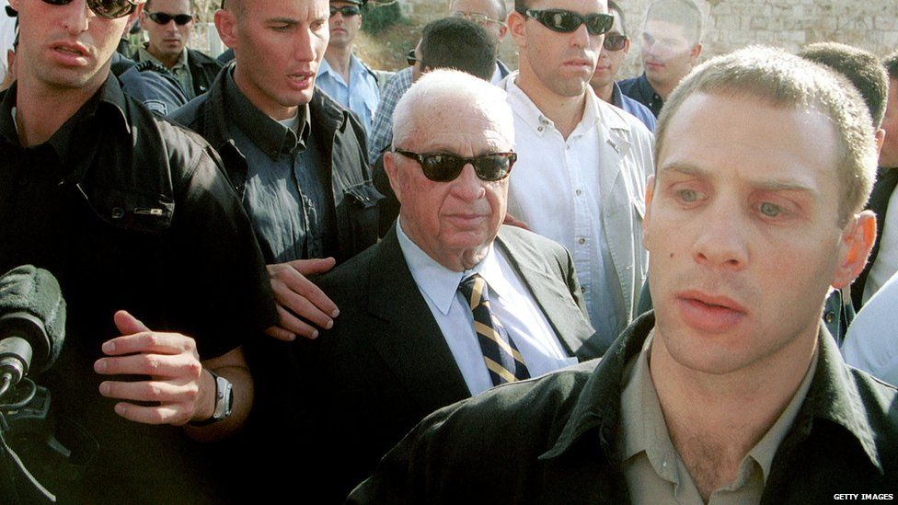
Israel’s Prime Ministers in the 1990s and 2000s
1992–1995
Yitzhak Rabin – What can you remember about Rabin from last lesson? Rabin was assassinated by an extremist in 1995 for his role in the Oslo Accords
1996
Shimon Peres
1996–1999
Benjamin Netanyahu
1999–2001
Ehud Barak – Barak joined Yasser Arafat and Bill Clinton for the 2000 Camp David Summit, which ultimately failed
2001–2006
Ariel Sharon – visited the Al-Aqsa compound in September 2000, sparking the Second Intifada

Slide 15
Using handout 13b, identify and explain the long-term, short-term and trigger causes of the Second Intifada:
Activity
Short-term causes
Causes of the Second Intifada
Trigger cause
Long-term causes
Extension question: Are any of the causes linked? Draw a line between causes that link and write a sentence underneath explaining the link between them

Slide 16
Group discussion
What was the most important cause of the Second Intifada?
Discuss this in your group. Be prepared to justify your answer to the rest of the class

Slide 17
13c. In your book, create a timeline of the Second Intifada using this information:
Sharon and Abbas sign a mutual truce at the Sharm el-Sheikh Summit on 8th February 2005
On 11th November 2004, Yasser Arafat dies in Paris. In early 2005, Mahmoud Abbas is elected President of the Palestinian Authority
Palestinians commemorate the Sabra and Shatila massacre on 18th September 2000. It had recently been ruled that Ariel Sharon bore some personal responsibility for the massacre
March 2002 sees many suicide bombings by Palestinians in Israel: around 130 Israelis are killed
Israeli Prime Ministerial candidate Ariel Sharon visits the Al-Aqsa Mosque compound on 28th September 2000. Sharon doesn’t enter Al-Aqsa Mosque itself, but Palestinians view this as antagonistic, and violence breaks out. Palestinians throw stones and the IDF fire rubber bullets and tear gas
Operation Defensive Shield by Israel takes place in the West Bank between March and May 2002. 500 Palestinians are killed and 5000 Palestinians are arrested
Bill Clinton, Yasser Arafat and Ehud Barak (Israeli Prime Minister) fail to reach an agreement at the Camp David Summit, July 2000
The Taba Summit takes place between Arafat and Barak in Taba, Egypt in January 2001. They fail to reach an agreement and the violence between Palestinians and Israelis continues
The Road map for peace (a plan to solve the Palestine-Israel issue) is introduced in 2002
In the final days of September and the first days of October 2000, violence spreads across East Jerusalem, the West Bank and Gaza
Extension question: Can you identify any similarities or differences with the First Intifada?

Slide 18
Now stick your timeline into your book
But did the violence end in February 2005? No. Attacks continued on both sides. We’ll come back to this next lesson, including the role of an organisation called Hamas
The Second Intifada, 2000-2005:
Operation Defensive Shield by Israel takes place in the West Bank between March and May 2002. 500 Palestinians are killed and 5000 Palestinians are arrested
ADD THIS TO YOUR TIMELINE!
Israeli Prime Ministerial candidate Ariel Sharon visits the Al-Aqsa Mosque compound on 28th September 2000. Sharon doesn’t enter Al-Aqsa Mosque itself, but Palestinians view this as antagonistic, and violence breaks out. Palestinians throw stones and the IDF fire rubber bullets and tear gas
Bill Clinton, Yasser Arafat and Ehud Barak (Israeli Prime Minister) fail to reach an agreement at the Camp David Summit, July 2000
The Taba Summit takes place between Arafat and Barak in Taba, Egypt in January 2001. They fail to reach an agreement and the violence between Palestinians and Israelis continues
On 11th November 2004, Yasser Arafat dies in Paris. In early 2005, Mahmoud Abbas is elected President of the Palestinian Authority
Palestinians commemorate the Sabra and Shatila massacre on 18th September 2000. It had recently been ruled that Ariel Sharon bore some personal responsibility for the massacre
In the final days of September and the first days of October 2000, violence spreads across East Jerusalem, the West Bank and Gaza
March 2002 sees many suicide bombings by Palestinians in Israel: around 130 Israelis are killed
The Road map for peace (a plan to solve the Palestine-Israel issue) is introduced in 2002
Sharon and Abbas sign a mutual truce at the Sharm el-Sheikh Summit on 8th February 2005

Slide 19
So why is the Second Intifada also known as the Al-Aqsa Intifada?

Slide 20
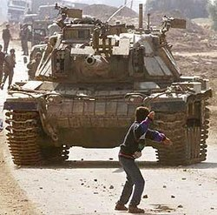
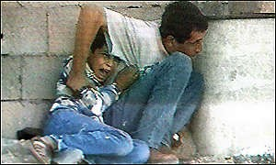
Famous photographs of the Second Intifada
On 29th October 2000, a photojournalist took this photo of 14 year old Faris Odeh throwing a stone at an IDF tank. When throwing stones ten days later, Faris was shot in the neck by IDF soldiers and died
On 30th September 2000, 12 year old Palestinian Muhammad al-Durrah was killed by Israeli soldiers whilst hiding behind his father. This tragic image was shared across the world
What emotions do these photos evoke?
How do these images make you feel?

Slide 21
https://www.youtube.com/watch?v=4NNz_FHCaBg1

Slide 22
Consequences of the Second Intifada for Palestine-Israel

Slide 23
Palestinian victims, 2000-2004:
Killed: 3,334
Injured: 52,000+
Students injured: 4,090
School attacked: 850
Palestinian journalists killed: 12
Overall damage to Palestinian economy: $10bn

Slide 24
Consequences of the Second Intifada
Over 3000 Palestinians and 1000 Israelis lost their lives
As we have already seen, the violence continued: has the Second Intifada really ended? (We will return to this in a future lesson)
Israel started building the Apartheid Wall in 2002
We will also return to this in a future lesson, but this is a wall that runs roughly along the border between Israel and the occupied West Bank. Israel has been criticised for using the Wall to take more Palestinian land
Israeli settlement building continued, despite the multiple UN Security Council Resolutions condemning this
Both Israelis and Palestinians felt increasingly discouraged about the idea of a “two-state solution” to the problem – how could a Palestinian state ever function? Would Israel ever let it? Would Israel ever be safe?
With the person next to you: what was the most important consequence of the Second Intifada? Was this different for Palestinians vs. Israelis? Why? Make a note of this in your books

Slide 25
Plenary: Second Intifada in brief
https://www.youtube.com/watch?v=WtfXjRI2AwU

Slide 26
Chapter Two Recap

Slide 27
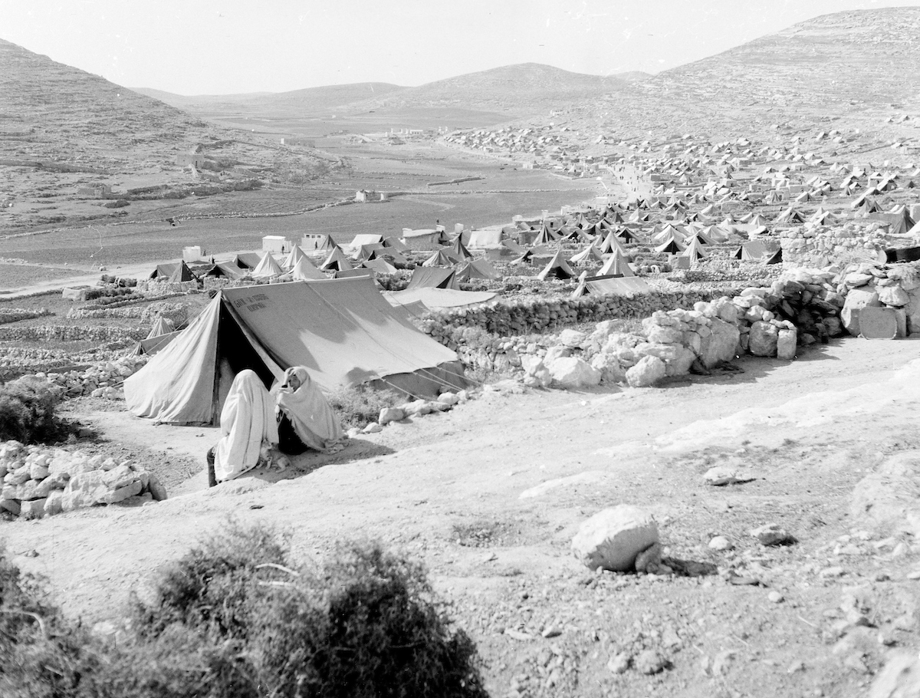
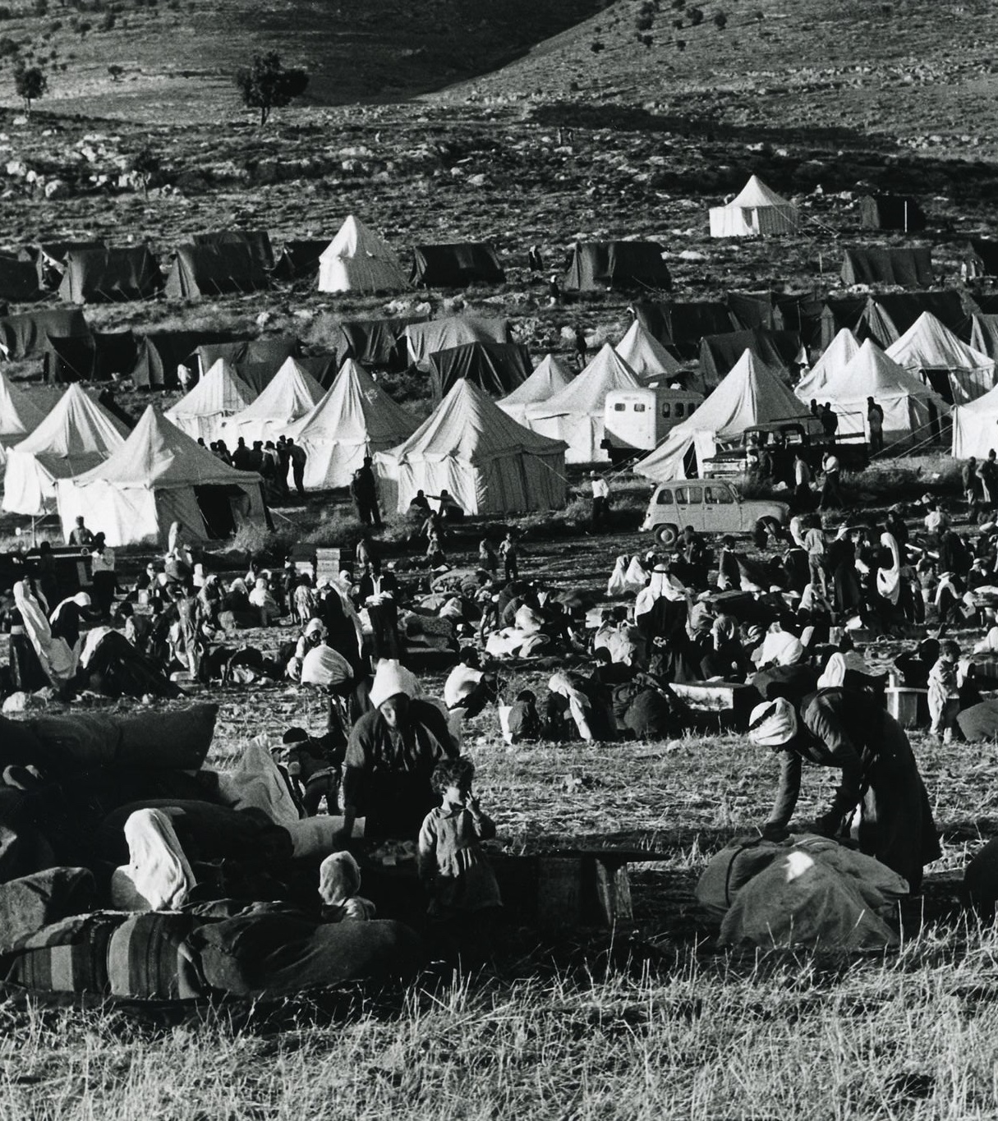
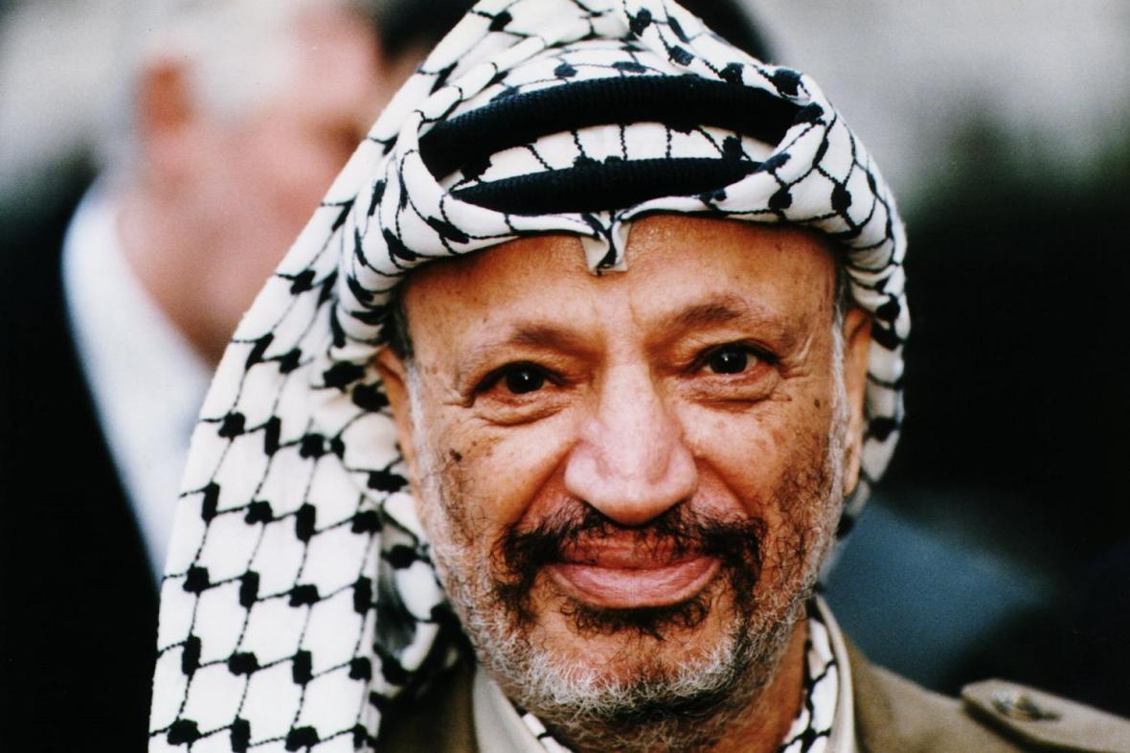
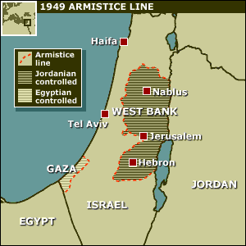
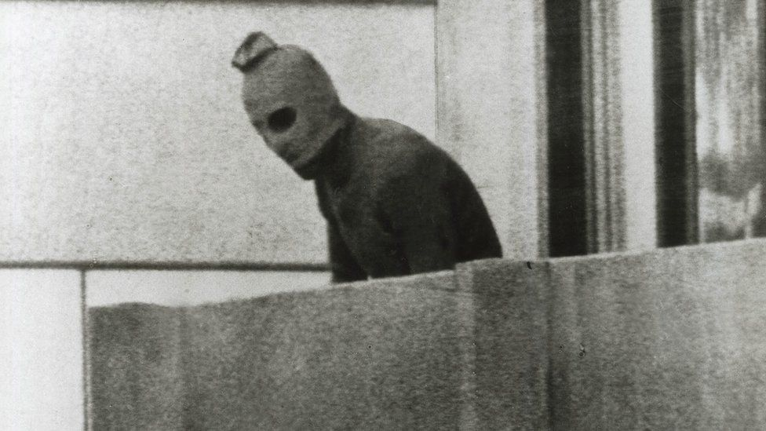
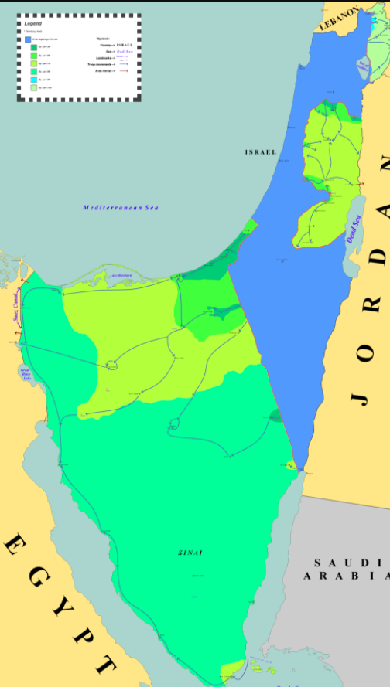
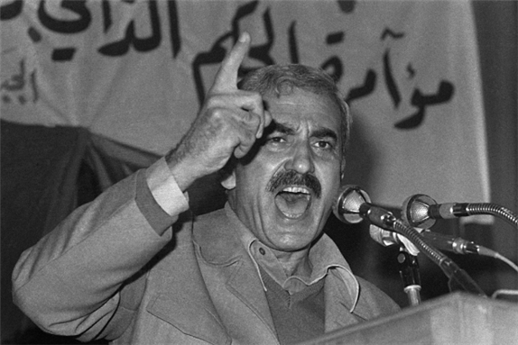
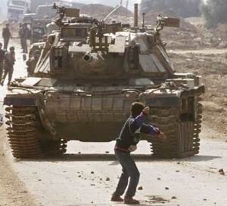
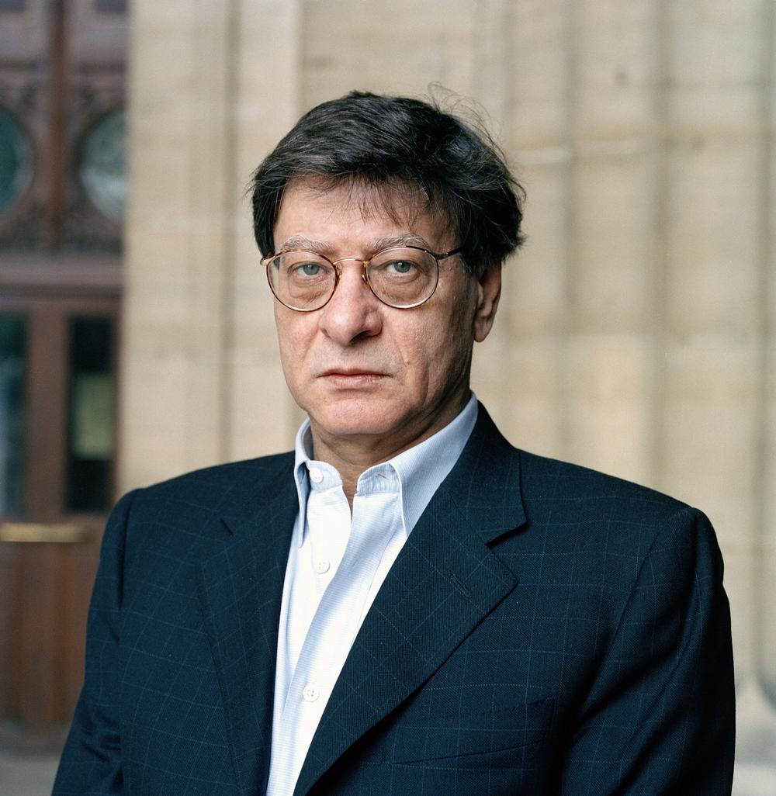
What have we covered in Chapter 2? Use these images to help you

Slide 28
What have we covered in Chapter 2? Use these images to help you
L8: What happened in the 1950s?
L9: What were the consequences of the June 1967 War?
L10: How did Palestinian nationalism change in the 1960s and 1970s?
L11: What were the causes and consequences of the First Intifada?
L12: How successful were the Oslo Accords?
L13: What were the consequences of the Second Intifada for Palestine-Israel?

Slide 29
Homework: Exam-style questions on Chapter Two
Explain two consequences of the June 1967 War for Palestinians (8 marks)
Write a narrative account analysing the key events that led to the First Intifada (8 marks)
Explain two of the following:
The importance of Yasser Arafat to Palestinian nationalism
The importance of the Oslo Accords to a ‘peace process’ for Palestine and Israel (16 marks)

